Slide 1

Introduction to Software Engineering (ISE102) Tutorial Week 3

Slide 2
Object-Oriented Programming (OOP) Basics
OOP is like building with LEGO:
Each LEGO piece = Object (it has shape, colour, purpose)
LEGO instructions = Class (blueprint to create objects)

Slide 3
Object-Oriented Programming (OOP) Basics
Key OOP ideas:
Class – blueprint (e.g., “Car” design)
Object – actual item made from the blueprint (e.g., a Toyota Corolla in Sydney)
Attributes – properties (e.g., colour, model)
Methods – actions (e.g., start engine, honk)

Slide 4
Object-Oriented Programming (OOP) Basics
Australian Example:
Class: Kangaroo
Objects: Red Kangaroo, Eastern Grey Kangaroo in NSW
Attributes: tailLength, weight
Methods: hop(), eatGrass()

Slide 5
Object-Oriented Programming (OOP) Basics
OOP Concept | Real-world Analogy | Australian Example
Class | Building design | "Opal Tower" plan in Sydney
Object | Actual building | Completed Opal Tower
Attributes | Room size, colour | Apartment floor plan
Methods | Actions | Lift moves, lights turn on

Slide 6
Object-Oriented Programming (OOP) Basics
Research Discussion Question: Why do modern apps in Australia (e.g., MyGov, Service NSW) use OOP rather than procedural programming?
Because OOP allows reusable code, easy maintenance, and modelling of real-world services like forms, accounts, and processes.

Slide 7
Object-Oriented Programming (OOP) Basics
Research Discussion Question: Why does Commonwealth Bank’s NetBank use OOP principles instead of procedural programming for its online banking platform?
OOP lets developers create reusable classes like Account, Transaction, and Customer, so features such as viewing statements or transferring money can be reused across mobile and web apps. It also makes it easier to maintain security, adapt to new regulations (like ASIC compliance), and roll out new services such as PayID without rewriting large parts of the system.

Slide 8
Object-Oriented Programming (OOP) Basics
Australian Real-World Analogy Think of NetBank as a shopping centre:
Classes = store blueprints (e.g., Woolworths, JB Hi-Fi)
Objects = actual store branches in the centre
Updating one blueprint updates all branches — just like updating one class in OOP updates all relevant objects in the system.

Slide 9
Hands-On Activity 1 (CBA_BankAccount_Deposit)
Write a class BankAccount in Java or Python with:
Two attributes: account_holder and balance
One method: deposit(amount) that increases the balance and prints the new balance

Slide 10
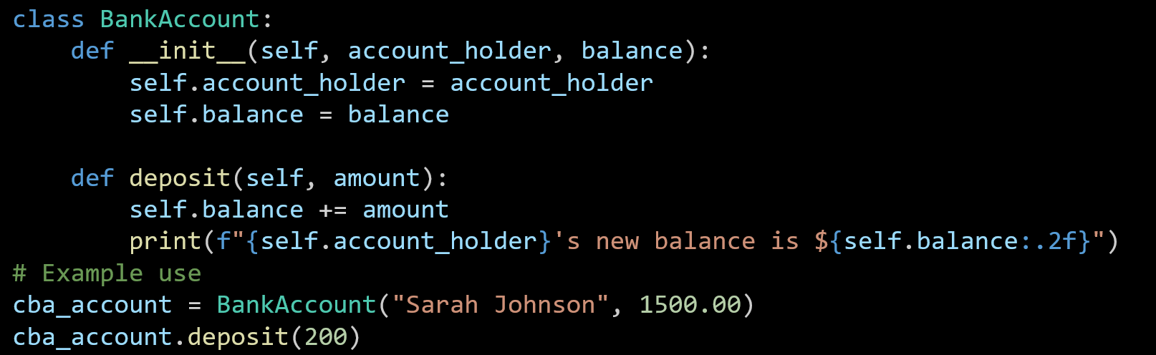
Hands-On Activity 1 (CBA_BankAccount_Deposit in Python)
The BankAccount class is created with two attributes: the account holder’s name and their balance.
The deposit method adds money to the balance and shows the updated amount.
An example account for Sarah Johnson is created, and $200 is deposited to update her balance.

Slide 11
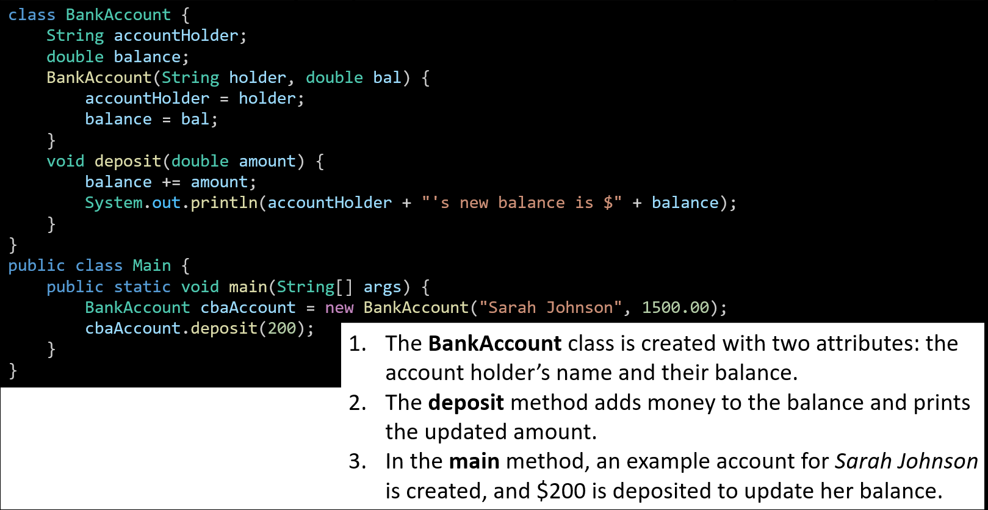
Hands-On Activity 1 (CBA_BankAccount_Deposit in Java)
The BankAccount class is created with two attributes: the account holder’s name and their balance.
The deposit method adds money to the balance and prints the updated amount.
In the main method, an example account for Sarah Johnson is created, and $200 is deposited to update her balance.

Slide 12
Hands-On Activity 2 (OOP Example – Train Class)
Build a class Train that can show the train number and destination (e.g., Sydney → Newcastle). Use Python or Java.

Slide 13
Hands-On Activity 3 (Create Your Favourite Aussie Sport Class)
Create a class for a favourite Aussie sport (e.g., CricketPlayer) with attributes and actions.

Slide 14
Hands-On Activity 4 (Create Multiple Objects and Call Their Methods)
Write code to create two different objects from the same class and call their methods.

Slide 15

Happy Learning and Bright Futures Ahead! Dr. Farshid Keivanian Stay Connected: linkedin.com/in/farshid-keivanian github.com/FarshidKeivanian
Education is the most powerful weapon you can use to change the world. — Nelson Mandela

